Slide 1
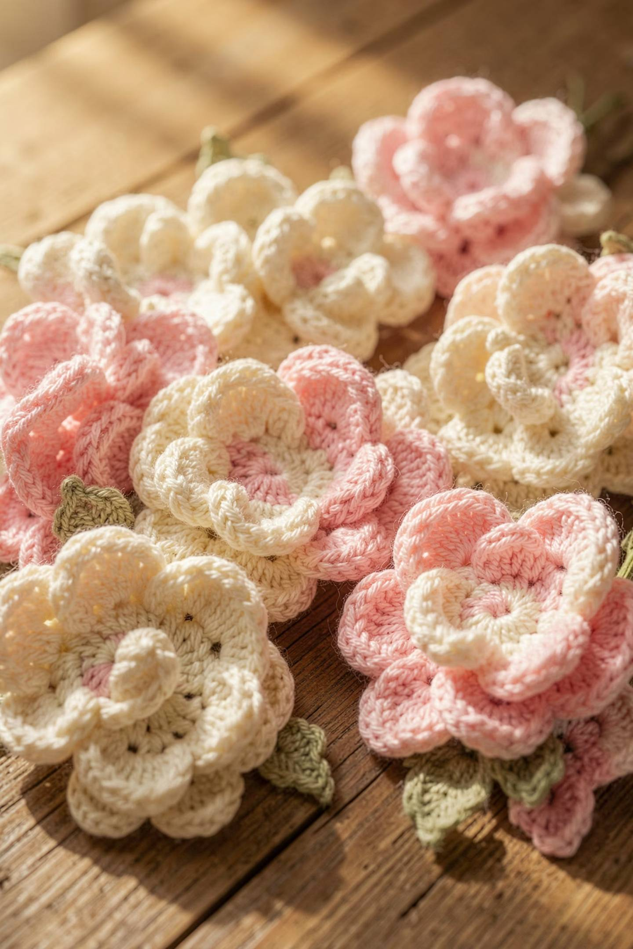
INTERNSHIP PROJECT
JUNE 2026
Yarn Charms
Growing a Handmade Crochet Brand Through Digital Marketing
Presented by Hafsa Sheraz · DevelopersHub Corporation

Slide 2

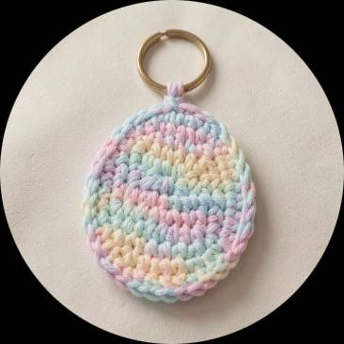
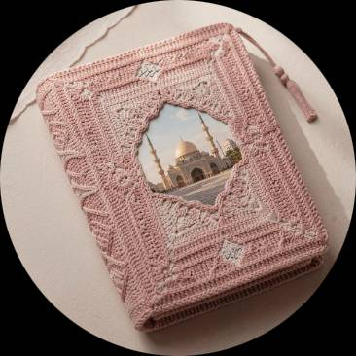
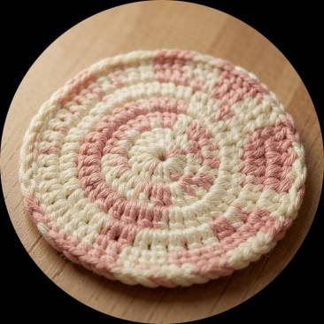
1
Meet Yarn Charms
Yarn Charms is a handmade crochet business creating thoughtful, aesthetic products — from floral arrangements to custom decor pieces.
Crochet Flowers
Keychains
Quran Covers
Coasters & Customs
Delicate, long-lasting floral arrangements
Charming everyday accessories
Reverent, personalized book covers
Functional art and bespoke orders
The business shares its creations primarily on Instagram and Facebook, aiming to build awareness, spark engagement, and attract customers through authentic digital storytelling.

Slide 3
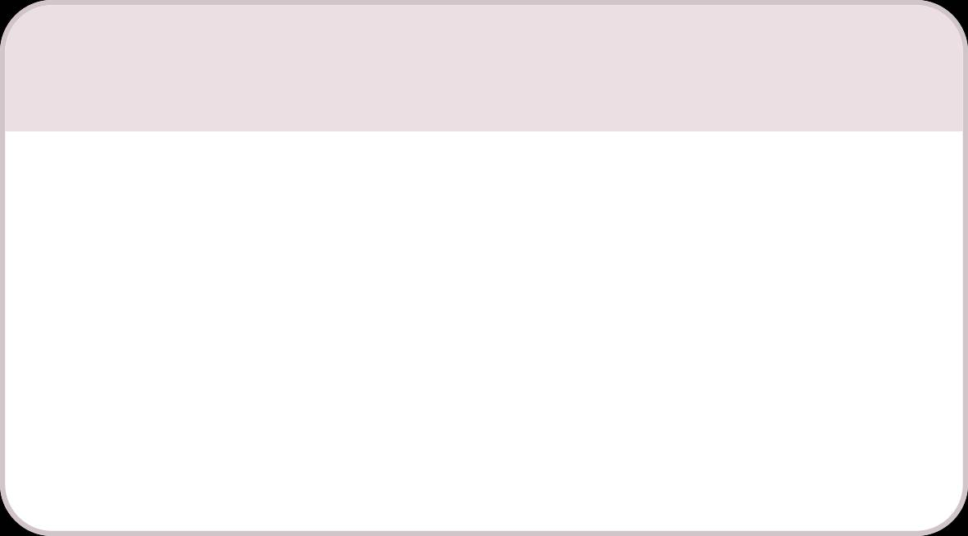
2
CHAPTER 1
Project Goals
Three SMART objectives guided every content decision during the internship — each one building on the last.
1
2
3
Brand Awareness
Audience Engagement
Business Growth
Increase Instagram followers by 10–15% through consistent, high-quality content posting.
Encourage likes, comments, shares, and saves through educational and interactive content.
Drive customer interest through product promotion, tutorials, and profile visits.

Slide 4
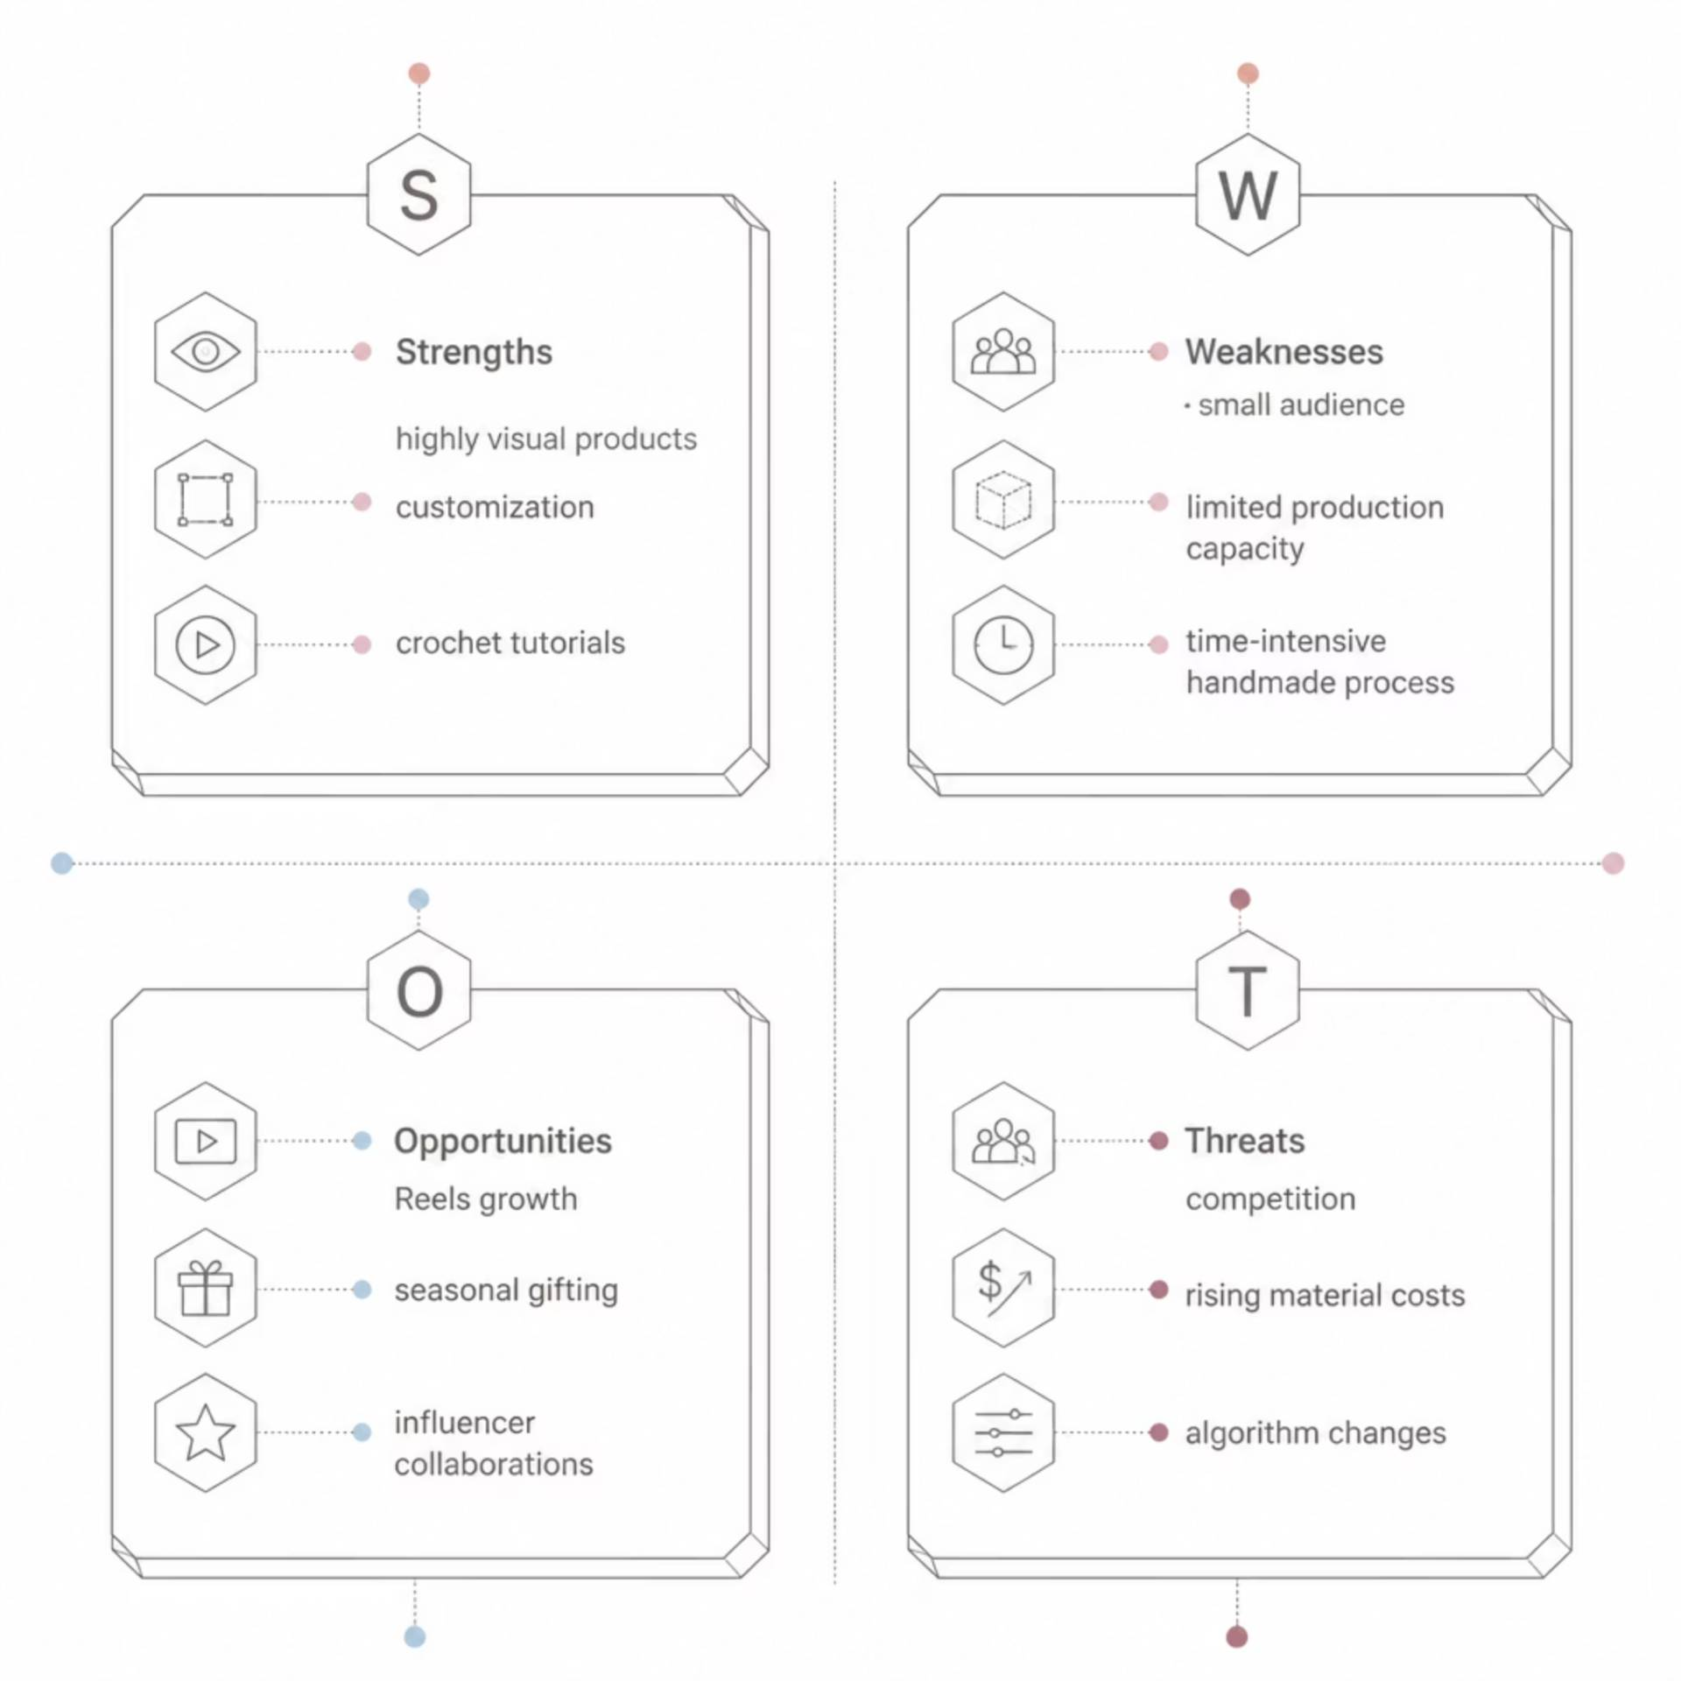
3
Understanding the Business
A SWOT analysis clarified where Yarn Charms stands — and where it can grow.
Handmade products are inherently visual and unique, but production capacity and audience size present real challenges. The opportunity lies in short-form video and seasonal gifting trends.

Slide 5
4
CHAPTER 2
Content Strategy
The 70 / 20 / 10 Rule shaped every post — because people engage more when they learn something before being sold something.
70% Educational
20% Engagement
10% Promotional
Tutorials, FAQs, and product usage tips
Polls, questions, and audience interaction
Product showcases and sales content

Slide 6
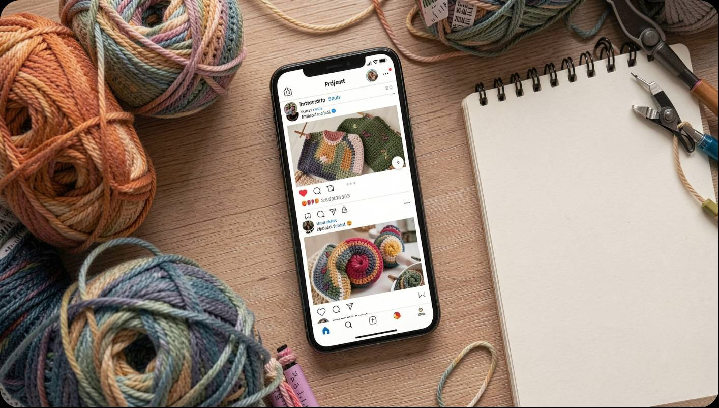
5
Content Created
Over the course of the internship, a diverse content portfolio was built across multiple platforms and formats:
Social Media Posts
LinkedIn Article
Ad Campaigns
5 posts across Instagram & Facebook
1 long-form article published
2 mock Meta Ads campaigns
Video Reels
Email Newsletter
LinkedIn Updates
2 tutorial-style reels
1 campaign via Mailchimp
9 professional posts

Slide 7
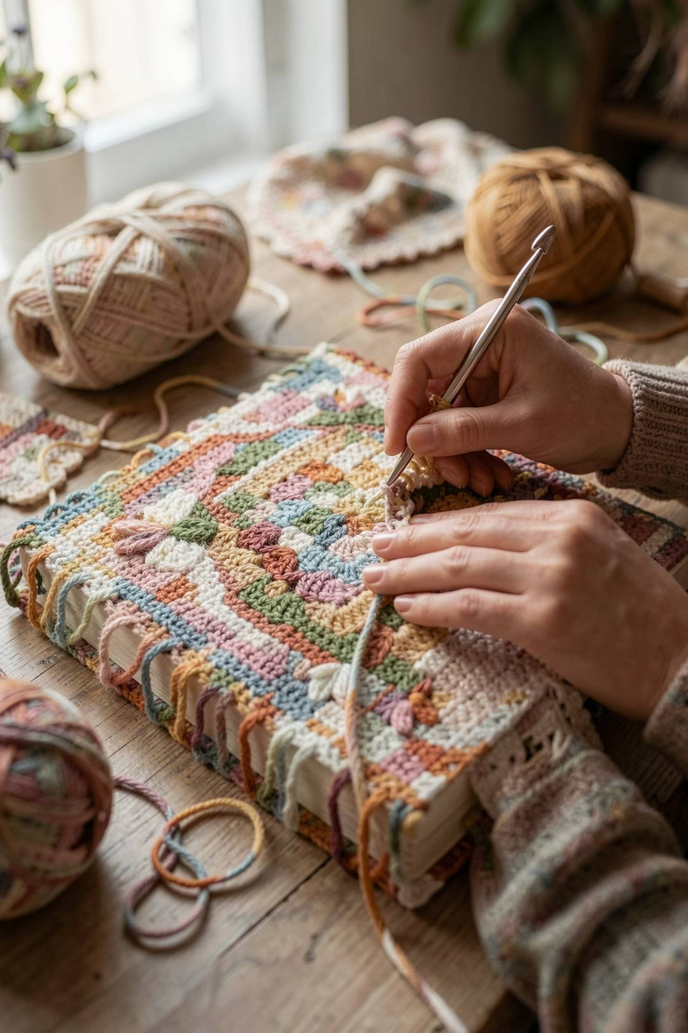

6
What Worked Best
The top-performing reel was a Crochet Quran Cover Tutorial — combining education with a clear call-to-action.
1,991
Views
1,684
Reach
12
Saves
+5
Followers
Key Lesson: People love content that solves a problem. Educational, useful, easy-to-understand content consistently outperformed promotional posts.

Slide 8
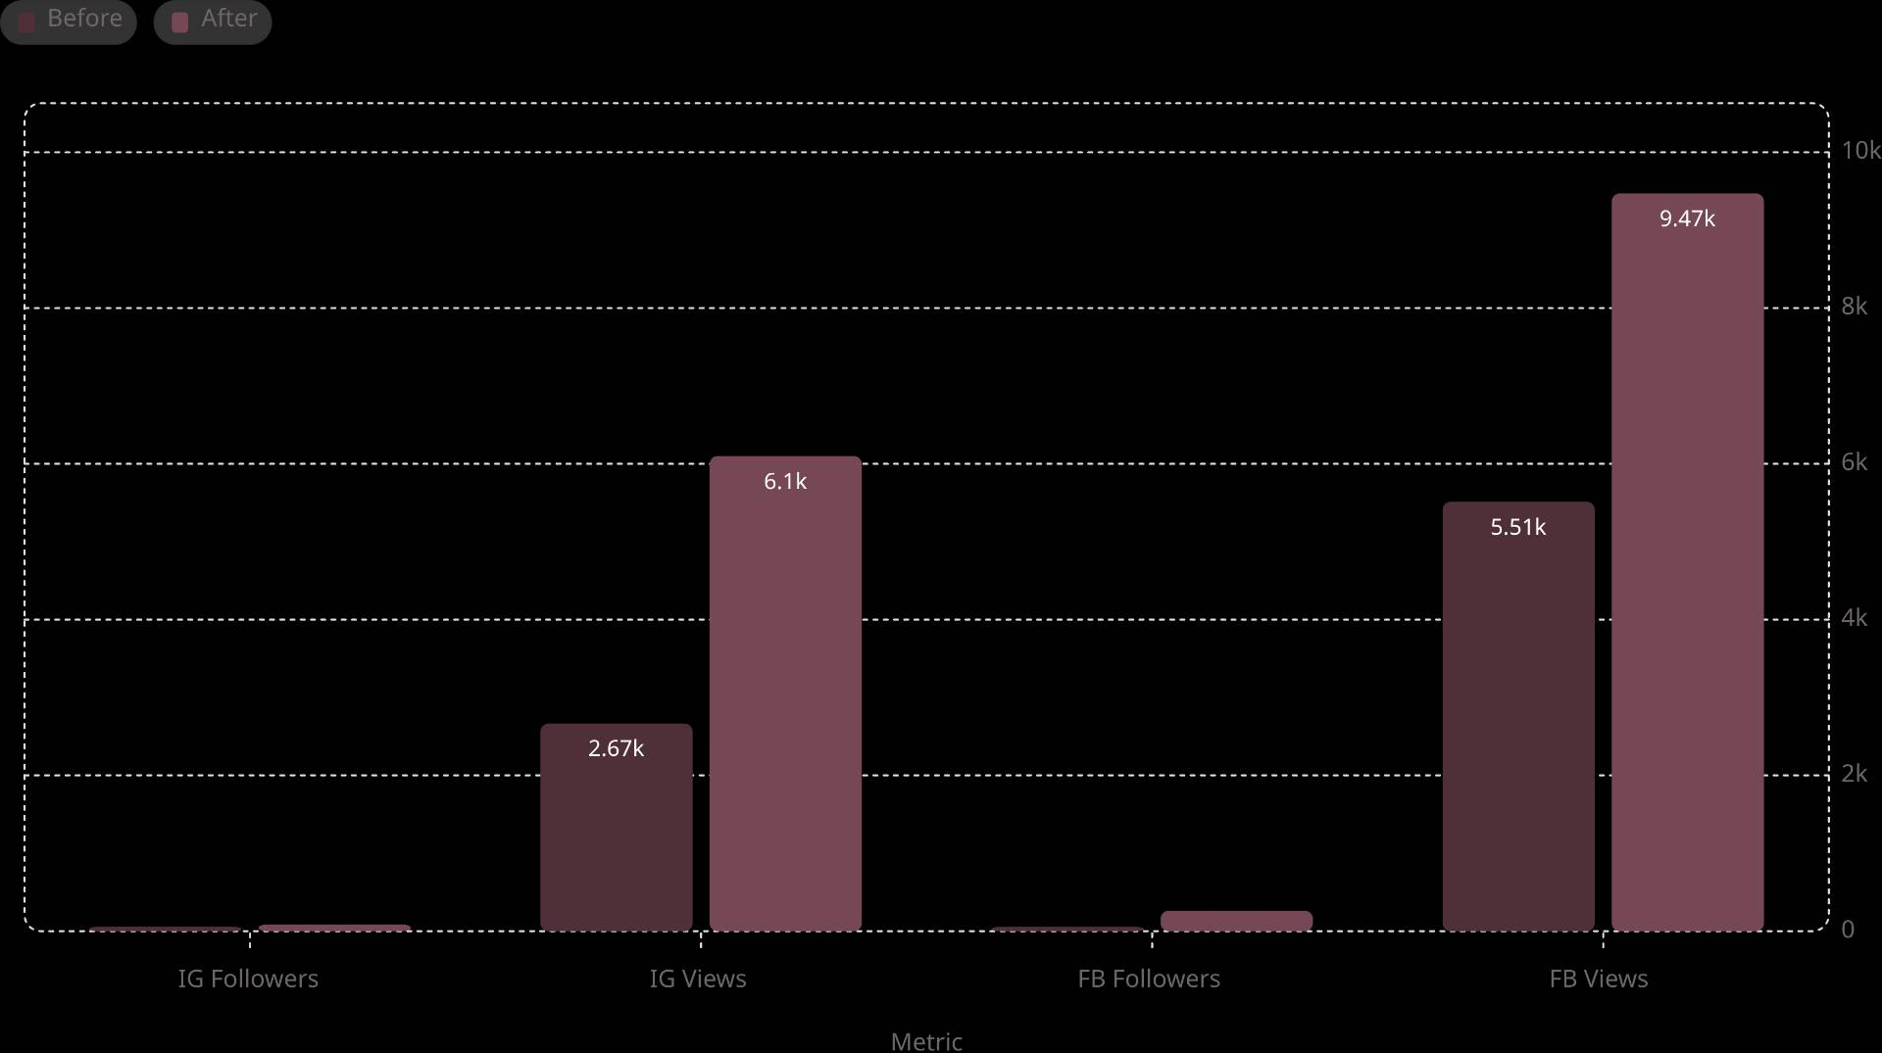
CHAPTER 3
7
Growth Achieved
Every SMART goal was achieved and exceeded across both platforms.
Instagram Growth
Profile Visits
Facebook Growth
+54.5% followers
+265% increase
+385% followers

Slide 9
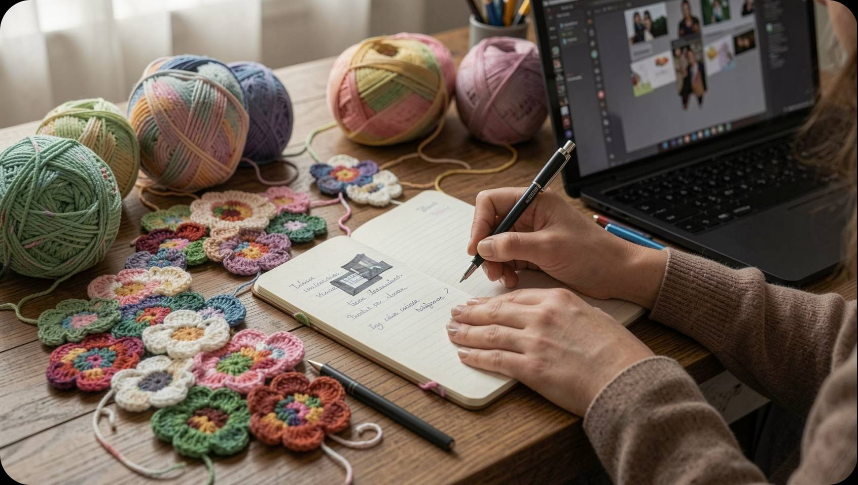

8
CONTENT MARKETING
LINKEDIN ARTICLE
"Why Crochet Gifts Hold More Value Than Retail Luxury"
Instead of competing on price, the article positioned handmade crochet products as meaningful, personalized gifts — using storytelling, emotional value, and accessible formatting.
200 Impressions
116 Reach · 6 Engagements
2 Comments · 1 New Follower

Slide 10
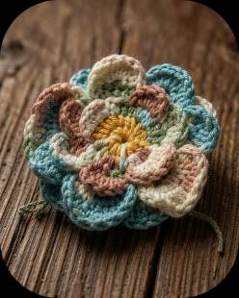
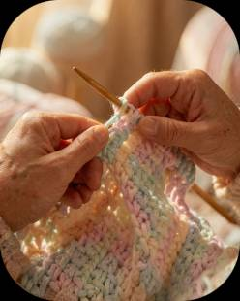
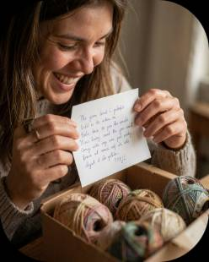

9
EMAIL MARKETING
MAILCHIMP
Campaign Strategy
Handmade Value
Craftsmanship
Emotional Connection
It highlighted handcrafted techniques, materials, and the time behind each piece to connect with makers and appreciative buyers.
Stories about process and small-batch production created authenticity—readers felt the maker’s presence, not a storefront pitch.
Content focused on feelings—gift moments, cozy rituals, and the meaning of handmade—so the message built rapport before any ask.
Approach: Educate and connect first; selling is the natural next step.

Slide 11
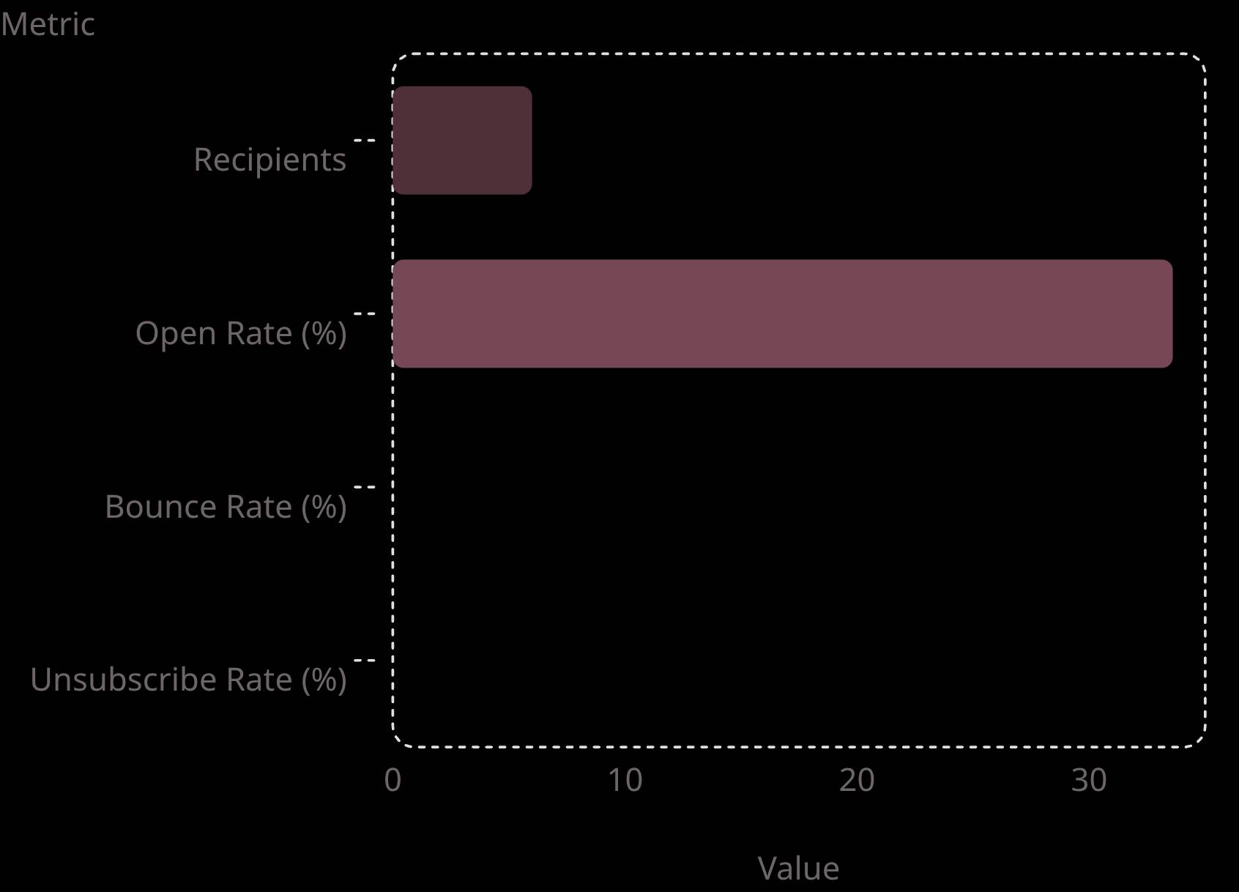
10
Campaign Performance
Interpretation:
Strong open rate for a tiny list indicates that subject lines and emotional content resonated.
Zero bounces/unsubscribes indicate list quality and relevancy.
Small sample size limits statistical confidence, but qualitative signals matter: inquiries and custom orders.

Slide 12
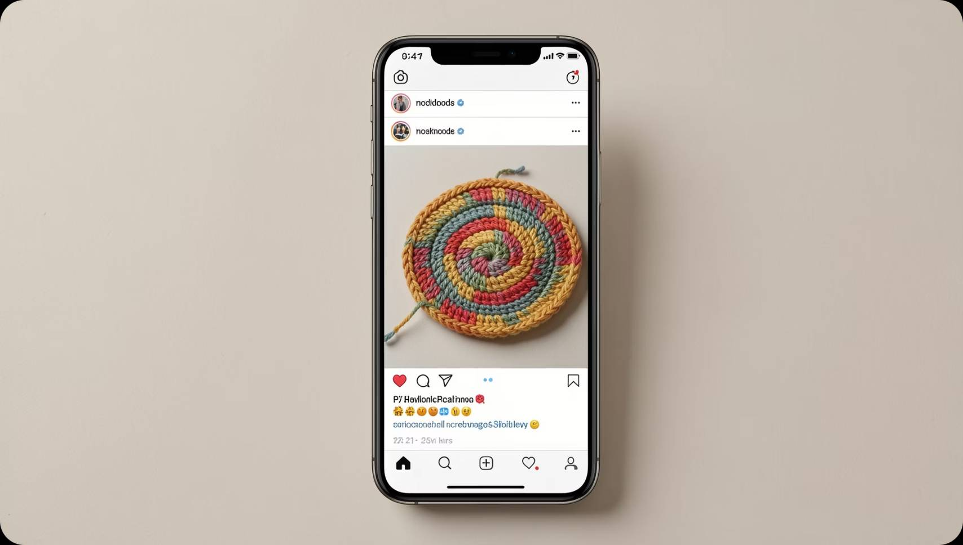
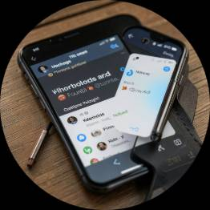
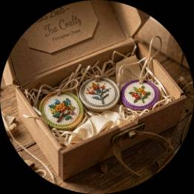
11
ADVERTISEMENT
META ADS MANAGER
Mock Meta Ads
Campaigns Designed
Outcome (mock): Ads weren’t run, but strategy clarified audiences and creative direction—ready to deploy when budget allows.
Ad Strategy
Two mock Ads were prepared, one for Awareness and second for Conversion.
Brand Awareness
Conversions
Target: Women 18–35 | Interests: Crochet, DIY | Budget: PKR 2,200 | 8 days
Target: Men & Women 18–35 | Interests: Gift Buyers, Home Décor | Budget: PKR 2,300 | 14 days
Real Business Impact
Customer Inquiry
Custom Orders
1 inquiry about crochet flower coaster pricing—direct evidence content sparked purchase interest.
3 custom orders received for items not even listed—shows trust and willingness to buy bespoke pieces.

Slide 13

12
Challenges & Solutions
Practical Solutions
Key Challenges
01
02
Scheduling issues in Meta Business Suite
Limited Mailchimp analytics
No current ad spend available
Manual Posting
Qualitative Analysis
Temporary but reliable—keeps content cadence while tools are fixed.
Combine open/click data with customer messages to surface what resonates.
03
Ad Readiness Plan
Keep mock campaigns polished, set creatives and audiences, and launch when budget permits.
Next Actions: grow list to 100 warm subscribers, A/B subject lines, run a small PKR 1,000 test ad focused on custom orders.
Closing: Relationship-first marketing works for handmade businesses. Repeat what resonated, scale carefully, and let customer conversations guide product choices.

Slide 14
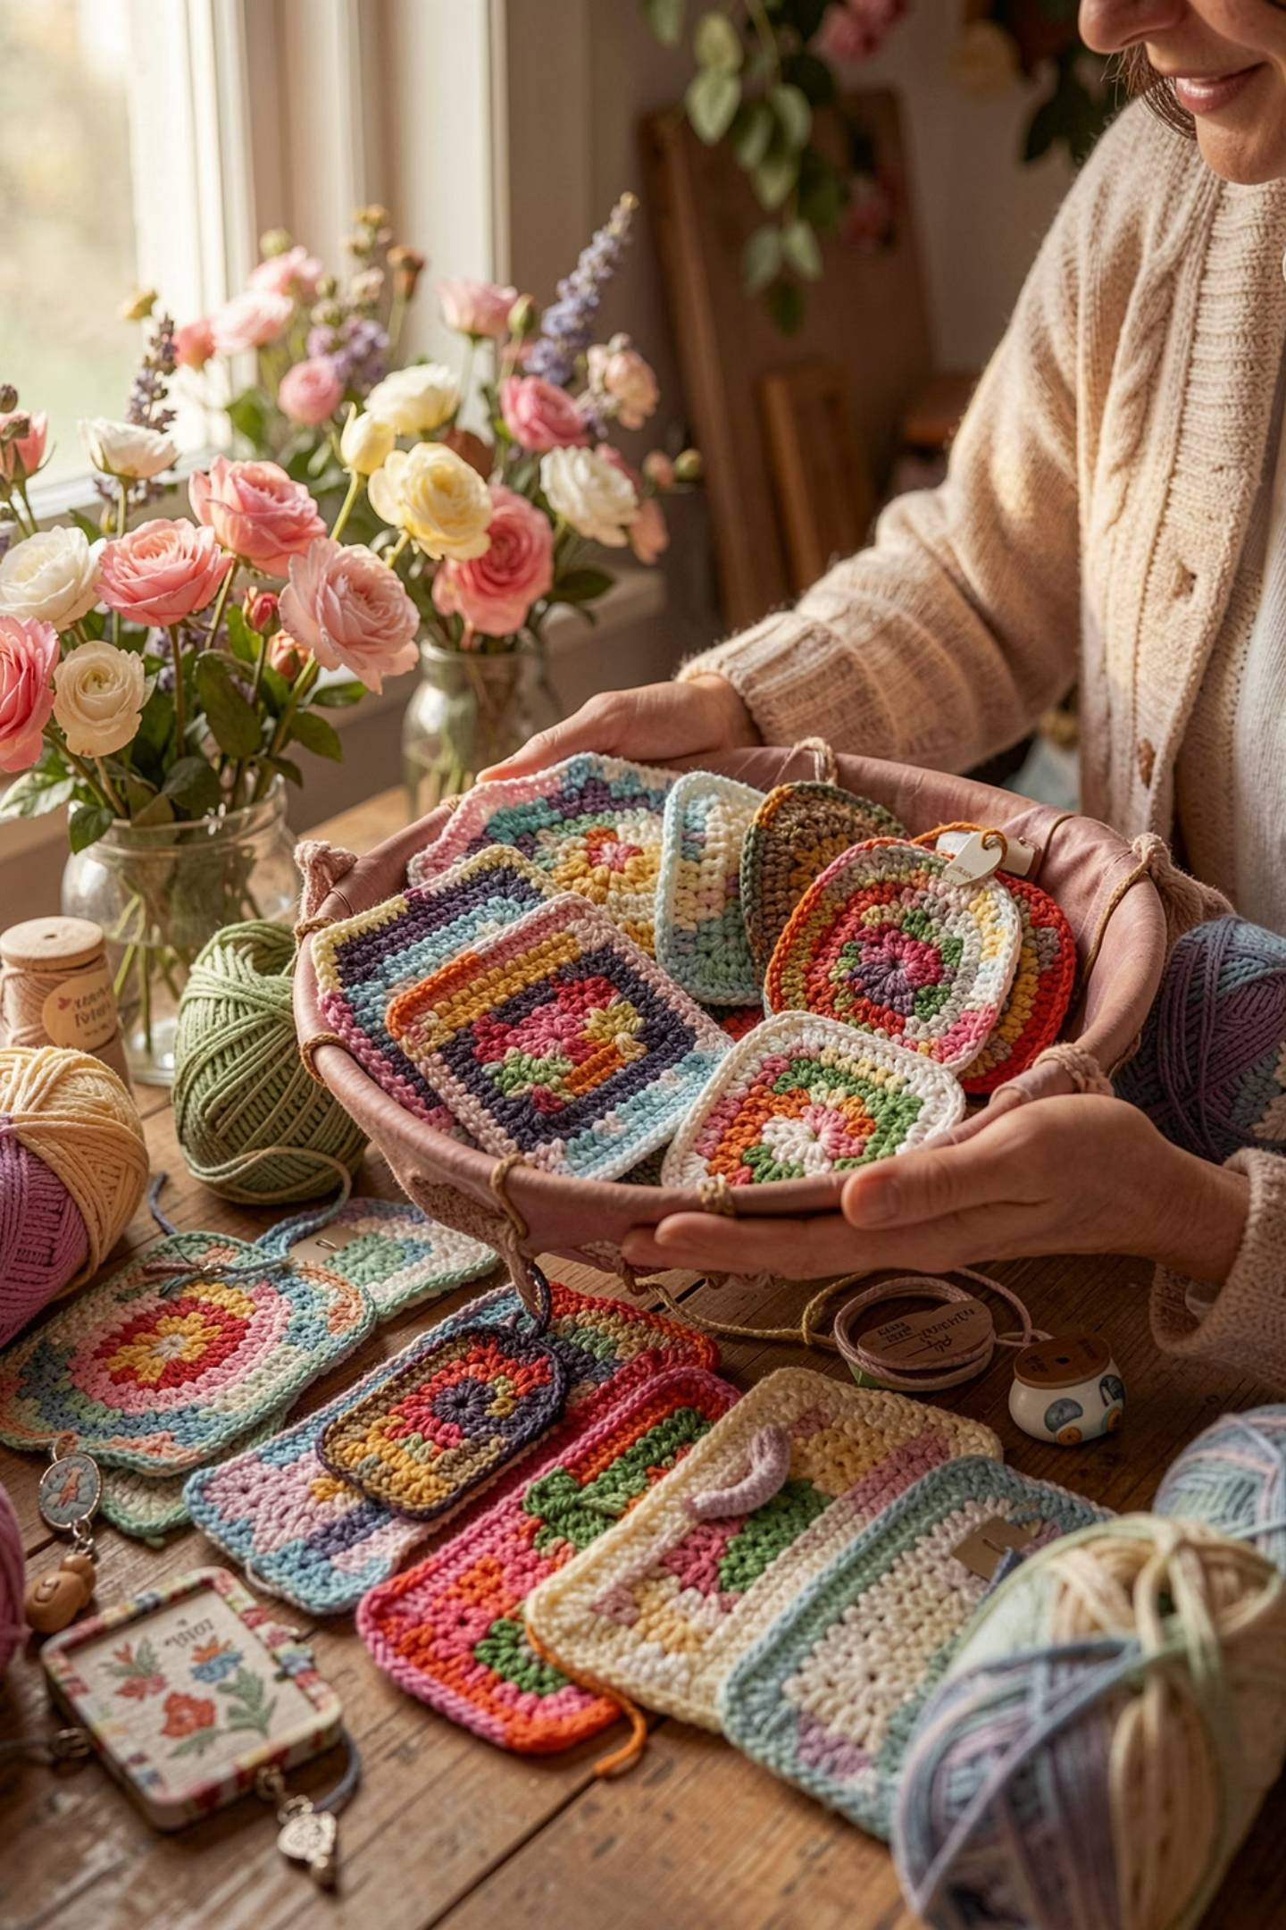
13
Moving Forward
This internship proved that educational content consistently outperforms promotional content — and that authentic storytelling drives real business results.
Future Plans
More educational reels, grow email list, launch paid ad campaigns, collaborate with creators, and continue the 70/20/10 strategy.
Skills Gained
Content marketing, social media strategy, email marketing, audience analysis, ad planning, performance reporting, and brand storytelling.
🌸 Thank you, DevelopersHub Corporation, for this learning opportunity.
Questions?

